Slide 1
205 Feb 14, Class 19
Final Projects
Plant et al. (2009), The Obama Effect
Chapter 15: Survey & instrument design

Slide 2
Final project groups
Formed with our help if requested
You should be added to a Canvas group with the rest of your research team
Communication through the Canvas group will let us also support your research plans and procedure development

Slide 3
Final projects, 10am
The Effect of Self-Perception on Creativity
Danielle, Leah, Lucy, Nithya
The Influence of Color and Gender on Mood
Gracey, Lea, Louisa, Patrick
Distracting Ringtones and Their Effects on Classroom Focus
Madison, Neil, Peter, Sophia
Impact of Confidence Priming on Self-Serving Bias in Memory
Camille, Myles, Philip
TBA
Asher, Charlotte, Dominic, Alena
TBA
Abigail, Esther, Katherine

Slide 4
Final Projects, 11am
Attachment style and intimacy in friendship
Hanna, Alexandra, Emilie, Hye-Won
Effects of time-pressure on decision making under uncertainty
Miles, Alex, Owen
Beauty Requires Thought
Quira, Ronghe, Meredith
Physical contact and financial risk taking
Yinghan, Alyssa, Cole
TBA
Matt, Claribel, Victoria
TBA
Seoyeon, Margot, Fernanda, Neha

Slide 5
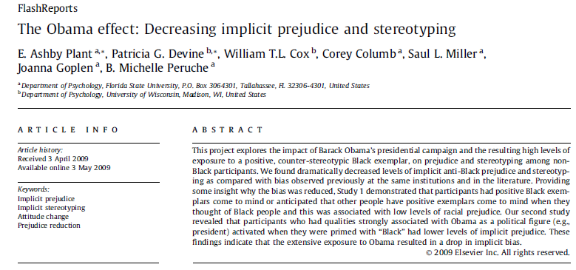

Slide 6
Evaluative IAT. The IAT is a dual categorization task in which participants categorize words as pleasant or unpleasant and faces as either Black or White by pressing one of two keys on the computer keyboard. Stimuli consisted of pleasant and unpleasant words as used by Greenwald et al. (1998) and pictures of White and Black male faces displaying neutral expressions (Malpass, Lavigueur, & Weldon, 1973) as used by Devine, Plant, Amodio, Harmon-Jones, and Vance (2002; Study 3). Pleasant words included honor, lucky, diamond, loyal, freedom, rainbow, love, honest, peace, and heaven. Unpleasant words included evil, cancer, sickness, disaster, poverty, vomit, bomb, rotten, abuse, and murder

Slide 7
IAT
Block 1: Is this word good or bad?
Block 2: Is this face black or white?
Blocks 3-4: Mixed together, compatible
Same hand for good/white, bad/black
Block 5: Mixed, incompatible
DV = RT on block 5 – average on 3 & 4

Slide 8
IAT Design
Aimed at overcoming response bias inherent in asking about racial stereotype/attitudes
Surveys can produce inaccurate data
Demonstrates the concept of ‘implicit’ elements of cognition
Unintentional bias
DV is fairly noisy
Can exhibit poor test-retest reliability

Slide 9
Non-experimental research
“The goal of this project was to explore whether Obama’s historic presidential campaign and the resulting high levels of exposure to a positive, counter-stereotypic Black exemplar led to reduced racial prejudice and stereotyping.”
Q1. Can we be confident about the causal direction here? Why or why not?
Q2. Give an alternate interpretation of the data. The interpretation must be with the data as observed (not an alternate outcome) but is a different inference.

Slide 10
Additional questions
Why could this research only be done non-experimentally?
If the authors interpretation of the effect is correct, what subsequent recent historic events might we see as having similar types of effects and what might these be?
What principle of survey question design is implicit in the procedure of the IAT?

Slide 11
Surveys & Instrument Design
Survey
Series of questions, often with a simple numerical response scale
Often used in non-experimental research
Relationships among responses used for sociology, economics, epidemiology
Instrument
Established series of questions to quantify a construct
Operational definitions
Happiness, depression
Personality measures
IQ

Slide 12
Survey research
Quality and effectiveness of questions
Demand characteristics
Complex or double-barreled questions
Sampling methodology
Recruiting bias
Participation/Non-response bias
Inaccurate responses

Slide 13
Bias
1. What is meant by “selection bias” in the context of survey research?
a. The survey participants are not randomly chosen from the population.
b. The survey participants are randomly chosen from the population.
c. The survey participants are not part of the population of interest.
d. The survey participants are a part of the population of interest.

Slide 14
2. Which bias occurs when individuals who were contacted chose to complete the survey differ in some ways from others who were contacted but chose not to take the survey?
a. Response set
b. Non-response
c. Attrition
d. Motivated respondent

Slide 15
Explain how each of the following two questions are examples of “double-barreled” questions:
Please agree or disagree with the following statement: Cars should be faster and safer.
How satisfied are you with your pay and job conditions?

Slide 16
Instrument development
Reliability measures
Test-retest reliability: for measures that are hypothesized to be stable over time
Inter-item reliability: statistical tools for assessing relationships among items supposed to tap the same constructs
Validity measures
Construct/Face validity
Convergent validity with existing measures
Discriminant validity versus existing measures

Slide 17
How Happy Are You?
How do we turn happiness into a number?
Operational definition
Online survey:
https://www.happiness-survey.com/

Slide 18
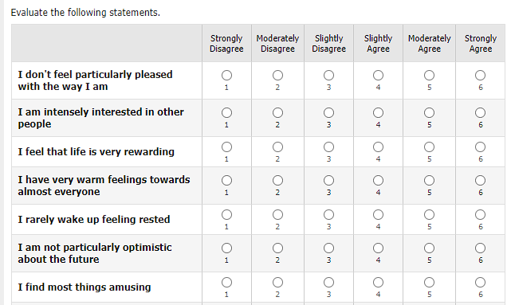
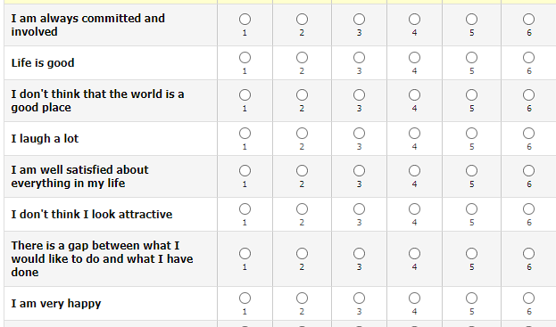
OHQ online survey

Slide 19
Oxford Happiness Questionnaire
INSTRUCTIONS. Below are a number of statements about happiness. Would you please indicate how much you agree or disagree with each by entering a number alongside it according to the following code:
1=strongly disagree; 2=moderately disagree; 3=slightly disagree; 4=slightly agree; 5=moderately agree; 6=strongly agree.
I feel that life is very rewarding
I am well satisfied about everything in my life
I don't feel particularly pleased with the way I am (−)

Slide 20
Using an existing scale
Follow the directions in the publication that describes and establishes scale validity
Note varieties: 29 items or 8 (short form)
Use all items in form selected
Following scoring procedure
Flip reverse items
Usually sum, sometimes weighting
Hills, P., & Argyle, M. (2002). The Oxford Happiness Questionnaire: a compact scale for the measurement of psychological well-being. Personality and individual differences, 33(7), 1073-1082.

Slide 21
Scale versus Item
General Social Survey
Nationally representative survey of adults in the US since 1972
Several thousand households, several hundred questions
“Taken all together, how would you say things are these days--would you say that you are very happy, pretty happy, or not too happy?”
General note: Multi-item scales are preferable
More reliable, less measurement error
Take longer to complete

Slide 22
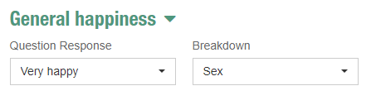
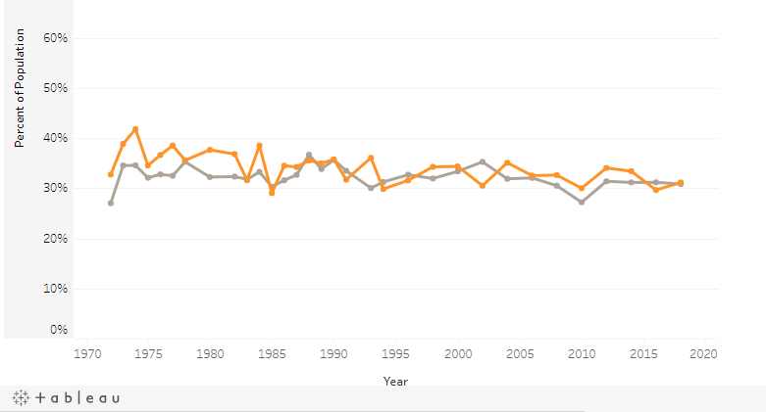
GSS: Happiness

Slide 23
Polling
In the hours after President Clinton's November 27, 1995, speech announcing that 20,000 U.S. troops would be sent to Bosnia as part of a NATO peace-keeping mission, three major news organizations took reaction polls.
CBS found that only 33% in favor, 58% opposed
ABC reported 39% in favor, 57% opposed
CNN/USA Today/Gallup found 46% in favor, 40% opposed
Did the US population support the initiative?
CNN/USA Today/Gallup didn’t mention the number of troops
ABC used the phrase “enforcing the peace agreement”

Slide 24
Challenges of Accurate Polling
Reaching your sample
Landlines versus cellphones versus online surveys
Matching the population
Assessing demographics of sample
Assessing demographics of population (voters)
Quantitative adjustment to match
Biased/unbiased questions
“Push-polling” as a technique to influence voters
Difficulty of wording related to reproductive choice

Slide 25
For Fri 2/16
Read Stephens et al. (2009)
Answer questions on Canvas

